Slide 1
QMST 5335
Module 2.1
Basics of Queueing Theory

Slide 2
Learning Objectives:
New Textbook (SS): https://textbook.simio.com/books/SASMAA6.php
Understanding basics of queueing systems (SS Chapter 2.1)
  Elements, applications, processes
Understanding basic performance measures and relations (SS Chapter 2.2)
  Key performance measures, Little’s Law
Learning some specific queueing systems and their analyses (SS Chapter 2.3)
  M/M/s and others
Getting familiar with several practical queueing system concepts
  Server utilization, pooling servers

Slide 3
Outline
Queueing-System Structure and Terminology
Key Performance Measures, Little’s Law, and Other Relations
Some Queueing Systems
M/M/1 Derivations
Review of Queueing Basics
  A Case Study and Key Insights

Slide 4
Outline
Queueing-System Structure and Terminology
Key Performance Measures, Little’s Law, and Other Relations
Some Queueing Systems
M/M/1 Derivations
Review of Queueing Basics
  A Case Study and Key Insights

Slide 5
Queueing-System Structure and Terminology
A basic queuing system:
  “Customers” show up, wait for “service,” get served, maybe go elsewhere, wait again, get served again, etc., maybe leave
  A simple representation:
A funny video:
https://www.youtube.com/watch?v=IPxBKxU8GIQ

Slide 6
Queueing-System Structure and Terminology
There are many practical applications of queueing systems
System | “Customers” | “Servers”
Manufacturing | Parts | Machines, people, transport
Urgent-care clinic | Patients | Doctors, nurses, other staff, rooms
Supply chain | Parcels, loads, trucks | Docks, warehouse space, trucks
Bank | Customers | Tellers, loan officers, drive-throughs
Amusement park | Guests | Rides, food stands, urgent-care clinic
Computer lab | Students | Computers, printers, help staff
Telecommunications | Messages, packets | Terminals, relays, switches
Traffic intersection | Vehicles, pedestrians | Segments of space in the intersection

Slide 7
Queueing-System Structure and Terminology
There are many practical applications of queueing systems
  Commercial Service Systems:
Type of System | Customers | Server(s)
Barber shop | People | Barber
Bank teller services | People | Teller
ATM machine service | People | ATM machine
Checkout at a store | People | Checkout clerk
Plumbing services | Clogged pipes | Plumber
Ticket window at a movie theater | People | Cashier
Check-in counter at an airport | People | Airline agent
Brokerage service | People | Stock broker
Gas station | Cars | Pump
Call center for ordering goods | People | Telephone agent
Call center for technical assistance | People | Technical representative
Travel agency | People | Travel agent
Automobile repair shop | Car owners | Mechanic
Vending services | People | Vending machine
Dental services | People | Dentist
Roofing Services | Roofs | Roofer
Source: “Introduction to Management Science: A Modeling and Case Studies Approach with Spreadsheets”, 5th edition, by F. S. Hillier and M. S. Hillier, McGraw-Hill Publication

Slide 8
Queueing-System Structure and Terminology
There are many practical applications of queueing systems
  Internal Service Systems:
Type of System | Customers | Server(s)
Secretarial services | Employees | Secretary
Copying services | Employees | Copy machine
Computer programming services | Employees | Programmer
Mainframe computer | Employees | Computer
First-aid center | Employees | Nurse
Faxing services | Employees | Fax machine
Materials-handling system | Loads | Materials-handling unit
Maintenance system | Machines | Repair crew
Inspection station | Items | Inspector
Production system | Jobs | Machine
Semiautomatic machines | Machines | Operator
Tool crib | Machine operators | Clerk
Source: “Introduction to Management Science: A Modeling and Case Studies Approach with Spreadsheets”, 5th edition, by F. S. Hillier and M. S. Hillier, McGraw-Hill Publication

Slide 9
Queueing-System Structure and Terminology
There are many practical applications of queueing systems
  Transportation Service Systems:
Type of System | Customers | Server(s)
Highway tollbooth | Cars | Cashier
Truck loading dock | Trucks | Loading crew
Port unloading area | Ships | Unloading crew
Airplanes waiting to take off | Airplanes | Runway
Airplanes waiting to land | Airplanes | Runway
Airline service | People | Airplane
Taxicab service | People | Taxicab
Elevator service | People | Elevator
Fire department | Fires | Fire truck
Parking lot | Cars | Parking space
Ambulance service | People | Ambulance
Source: “Introduction to Management Science: A Modeling and Case Studies Approach with Spreadsheets”, 5th edition, by F. S. Hillier and M. S. Hillier, McGraw-Hill Publication

Slide 10
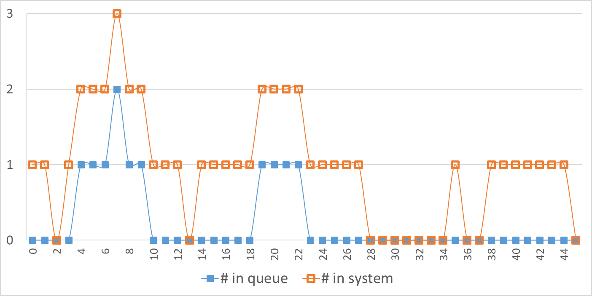
Queueing-System Structure and Terminology
A single-server queueing system example:
Registration
Interarrival times and service times are typically random (need to specify probability distributions for them)
Arriving
patients
Reg. Desk
Departing
patients
Patient being
registered
Queue
See ‘Module 2.1 -Simple Queue.xlsx’ for details

Slide 11
Queueing-System Structure and Terminology
A single-server queueing system example:
Often interested in output performance measures (metrics), like
  Total number of patients going from entry to exit over a fixed time period
  Average time in queue (waiting time), not counting service time
  Maximum time in queue, Time-average number of parts in queue
  Maximum number of patients in queue over a fixed time period
  Average patient time in system, Maximum patient time in system
  Utilization of the server (proportion of time busy)
Registration
Arriving
patients
Reg. Desk
Departing
patients
Patient being
registered
Queue

Slide 12
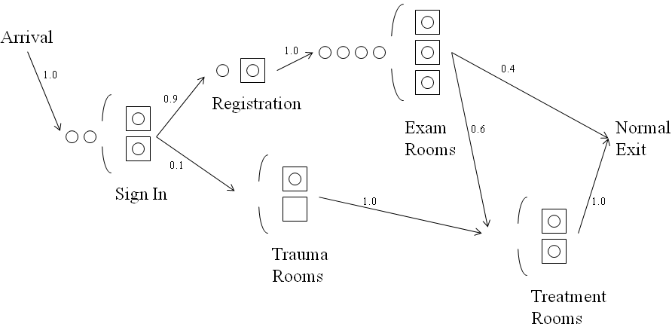
Queueing-System Structure and Terminology
A larger queueing system (network) example: Urgent-care clinic
  5 service stations (each is a node of the network)
    When there are multiple servers in a node, a single queue feeds them (rather than having separate queues for each individual server)
    The arcs define the probabilities that a patient will follow them
    An entity is waiting in queue if it is waiting in the line but not in service
      In Exam-Rooms station:
        There are 7 patients – 4 in queue, 3 in service

Slide 13
Queueing-System Structure and Terminology
A larger queueing system example: Urgent-care clinic
  Some questions:
    How many staff of which type during which time periods?
    How big should the waiting room(s) be?
    What would be the effect on patient waits if doctors and nurses tended to decrease or increase the time they spend with patients?
    What if 10% more patients arrived (arrival rate increased by 10%)?
    Should we serve patients in order of their acuity, or just first-in-first-out (FIFO)?

Slide 14
Queueing-System Structure and Terminology
In a queueing system
  Entities (like customers, patients, jobs) arrive, get served either at a single station or at several stations, may wait in queue(s), and may leave the system (if they do, it’s an open system, otherwise if they never leave it’s closed)
Arrivals
  The time between consecutive arrivals to a queueing system is called the interarrival time
  The expected number of arrivals per unit time is referred to as the mean arrival rate.
    The symbol used for the mean arrival rate is
    λ = Mean arrival rate for customers coming to the queueing system (λ lambda)
    →For instance, 5 customers per hour, 2 calls per minute, 12 cars per day…
    The mean of the probability distribution of interarrival times is
    1 / λ = Expected interarrival time
    →For instance, 12 minutes, 30 seconds, 2 hours…

Slide 15
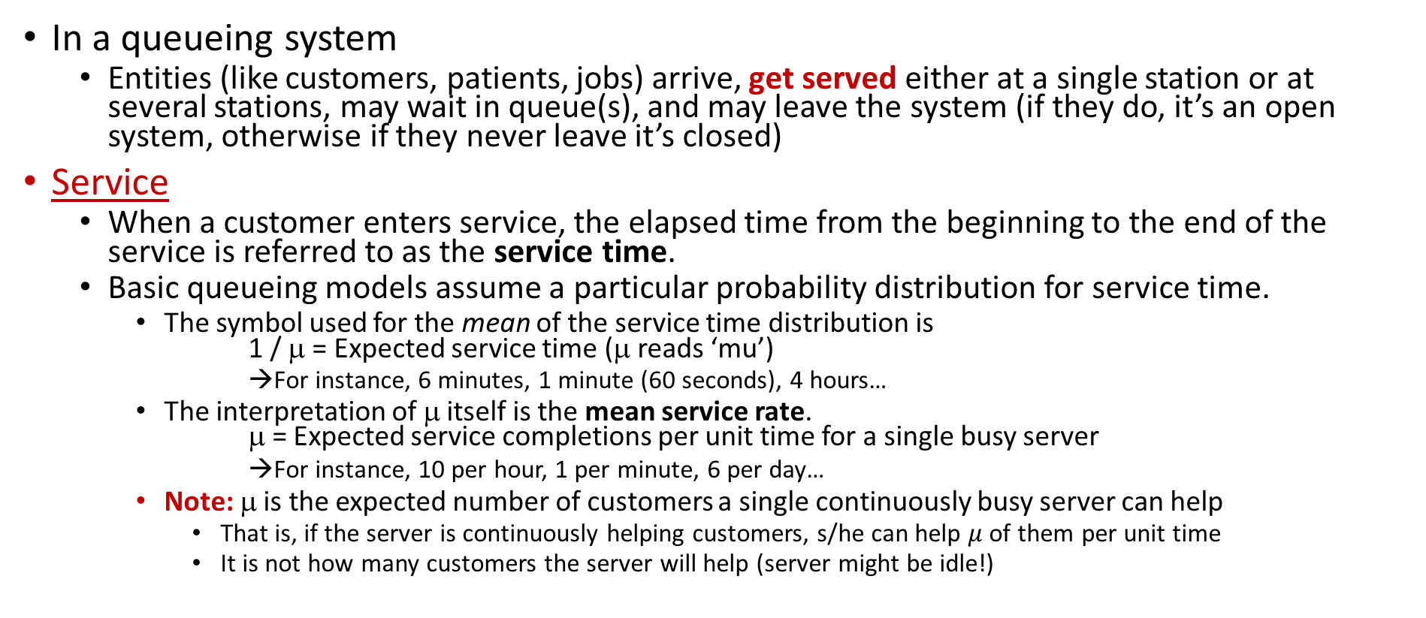
Queueing-System Structure and Terminology
In a queueing system
  Entities (like customers, patients, jobs) arrive, get served either at a single station or at several stations, may wait in queue(s), and may leave the system (if they do, it’s an open system, otherwise if they never leave it’s closed)
Service
  When a customer enters service, the elapsed time from the beginning to the end of the service is referred to as the service time.
  Basic queueing models assume a particular probability distribution for service time.
    The symbol used for the mean of the service time distribution is
    1 / μ = Expected service time (μ reads ‘mu’)
      →For instance, 6 minutes, 1 minute (60 seconds), 4 hours…
    The interpretation of μ itself is the mean service rate.
    μ = Expected service completions per unit time for a single busy server
    →For instance, 10 per hour, 1 per minute, 6 per day…
    Note: μ is the expected number of customers a single continuously busy server can help
      That is, if the server is continuously helping customers, s/he can help $μ$ of them per unit time
      It is not how many customers the server will help (server might be idle!)

Slide 16
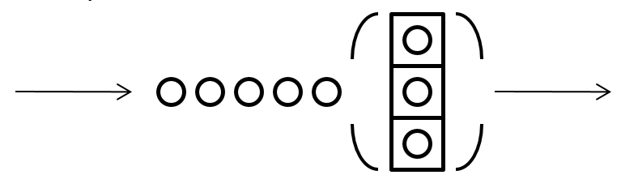
Queueing-System Structure and Terminology
In a queueing system
  Entities (like customers, patients, jobs) arrive, get served either at a single station or at several stations, may wait in queue(s), and may leave the system (if they do, it’s an open system, otherwise if they never leave it’s closed)
Queue
  Typically, a single queue defines a queuing system (maybe a node of a network)
    We might have multiple servers, but a single queue feeds them
    So, we usually assume that a single queue “feeds” all the parallel servers, and that the servers are identical in their service speeds
    When a single queue feeds multiple services, do not multiply the service rate with the number of servers!!! Service rate is defined for a single server!!!
  Queue disciplines – when an entity can leave the queue and start service, which entity gets to be the next one to be served?
    First-in, first-out (FIFO), a.k.a. first-come, first-served (FCFS)
    Last-in, first-out (LIFO) – a “stack” of physical or logical objects
    Priority – Shortest Job First (SJF); or Maximum Value First (MVF)
    Many others are possible…

Slide 17
Queueing-System Structure and Terminology
Common assumptions:
  c servers with a single queue with FIFO ordering
  A₁, A₂, …, A_{n} are IID random variables (interarrival times)
    λ is the arrival rate
  S₁, S₂, …, S_{n} are IID random variables (service times)
    μ is the service rate
    E(S)=1/ μ denotes expected service time
  A’s and S’s are independent
  ρ = λ/cμ is the utilization (of the server)
The system capacity (denoted by k) is the maximum number of customers that can be held in the system (those in queue plus in service).
  An infinite queue is one in which, for all practical purposes, an unlimited number of customers can be held there.
  When the capacity is small enough that it needs to be taken into account, then the queue is called a finite queue.

Slide 18

Queueing-System Structure and Terminology
Kendall’s notation:
  A/B/c/k queuing system
Dropped if infinite
Some notation:
M = Exponential
E_{k} = Erlang-k
U = Uniform
G = General
D = Deterministic
Some samples:
M/M/1
M/M/c
M/G/c
GI/G/c

Slide 19
Outline
Queueing-System Structure and Terminology
Key Performance Measures, Little’s Law, and Other Relations
Some Queueing Systems
M/M/1 Derivations
Review of Queueing Basics
  A Case Study and Key Insights

Slide 20
Key Performance Measures
Choosing a performance measure
  Managers who oversee queueing systems are typically concerned with two measures of performance:
      How many customers typically are waiting in the queueing system?
      How long do these customers typically have to wait?
  When customers are internal to the organization, the first measure tends to be more important.
    Having such customers wait causes lost productivity.
  Commercial service systems tend to place greater importance on the second measure.
    Outside customers are typically more concerned with how long they have to wait than with how many customers are there.
  Many other metrics can be used: cost, profit, safety, sustainability…

Slide 21
Key Performance Measures
Key performance metrics:
  L = Expected number of customers in the system, including those being served
    L(t) is the exact number of customers in the system at moment t
  L_{q}= Expected number of customers in the queue, excludes customers being served.
    L_{q}(t) is the exact number of customers in the queue at moment t
  W = Expected waiting time in the system (including service time) for an individual customer
  W_{q} = Expected waiting time in the queue (excludes service time) for an individual customer
  ρ = Utilization of a server, or of a group of parallel identical servers, the time-average number of individual servers in the group who are busy
    Note 1: These definitions assume that the queueing system is in a steady-state condition (i.e., not start-up, not temporary rush hour)
    Note 2: When we have a queueing network, these performance metrics can be defined for a node/station (a single queueing system by itself) or for the overall system

Slide 22
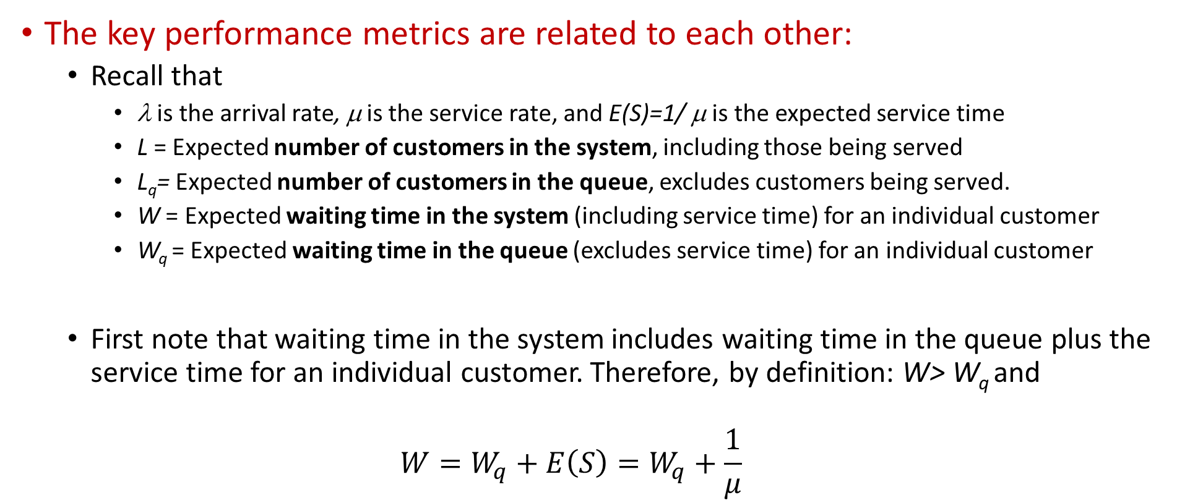
Little’s Law and Other Relations
The key performance metrics are related to each other:
  Recall that
    λ is the arrival rate, μ is the service rate, and E(S)=1/ μ is the expected service time
    L = Expected number of customers in the system, including those being served
    L_{q}= Expected number of customers in the queue, excludes customers being served.
    W = Expected waiting time in the system (including service time) for an individual customer
    W_{q} = Expected waiting time in the queue (excludes service time) for an individual customer
  First note that waiting time in the system includes waiting time in the queue plus the service time for an individual customer. Therefore, by definition: W> W_{q} and
  $$W=W_{q}+E\left(S\right)=W_{q}+\frac{1}{μ}$$

Slide 23
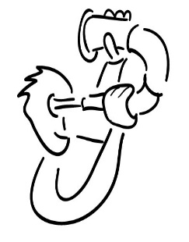
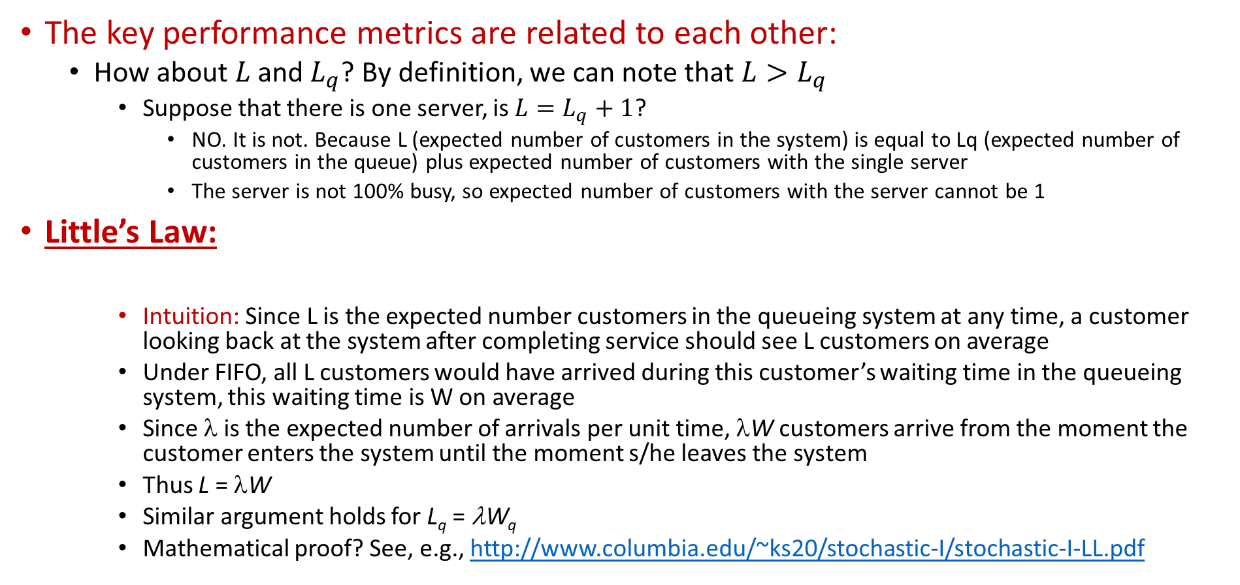
Little’s Law and Other Relations
The key performance metrics are related to each other:
  How about $L$ and $L_{q}$? By definition, we can note that $L>L_{q}$
    Suppose that there is one server, is $L=L_{q}+1$?
      NO. It is not. Because L (expected number of customers in the system) is equal to Lq (expected number of customers in the queue) plus expected number of customers with the single server
      The server is not 100% busy, so expected number of customers with the server cannot be 1
Little’s Law:
    Intuition: Since L is the expected number customers in the queueing system at any time, a customer looking back at the system after completing service should see L customers on average
    Under FIFO, all L customers would have arrived during this customer’s waiting time in the queueing system, this waiting time is W on average
    Since λ is the expected number of arrivals per unit time, λW customers arrive from the moment the customer enters the system until the moment s/he leaves the system
    Thus L = λW
    Similar argument holds for L_{q} = λW_{q}
    Mathematical proof? See, e.g., http://www.columbia.edu/~ks20/stochastic-I/stochastic-I-LL.pdf
L = λW and L_{q} = λW_{q}

Slide 24
Little’s Law and Other Relations
The key performance metrics are related to each other:
  Since 1/μ is the expected service time
  Using Little’s law
  These are important!!!
    Once we know one value, we can determine the others
W = W_{q} + 1/μ
  L = λW = λ(W_{q} + 1/μ) = λ(L_{q} / λ+ 1/μ)=L_{q} + λ /μ
L_{q} = λW_{q}
L = L_{q} + λ/μ

Slide 25
Little’s Law and Other Relations
The key performance metrics are related to each other:
  A small example (not in the book):
    λ = 3 customers per hour arrive on average
    μ = 4 customers per hour served (leave) on average
    W_{q} = ¾ hour waiting in the queue on average
      1/ μ = ¼ hour service time on average
      W=W_{q} + 1/μ = ¾ + ¼ = 1 hour
        1 hour waiting in the queueing system on average
      L=λW =3 customers/hour * 1 hour/customer = 3 customers
        3 customers in the queueing system on average
      L = L_{q} + λ/μ → 3 = L_{q} + ¾ → L_{q} = 9/4 customers
        9/4 customers in the queue on average
  These relations hold for any queueing system (in steady state)!
    Single server / Multiple servers or single system / queuing network
    Any interarrival time distribution, service time distribution
    Only requirement is that the system is non-preemptive (i.e., a customer’s service is not interrupted by arrival of another customer (say higher priority) or some other events)
W = W_{q} + 1/μ
L = λW
L_{q} = λW_{q}
L = L_{q} + λ/μ

Slide 26
Little’s Law and Other Relations
Other important points:
  To have a feasible system, server utilization should be less than 1
  Recall that ρ = Utilization of a server
  So, for feasibility, we should have ρ<1 (not that it is strictly less than 1)
    In a single server queueing system (i.e., c=1), this means ρ = λ/μ <1
      Makes sense! If customers arrive faster than what the server can help, the queue will build up to inf.
    In a multiple server queuing system (i.e., c>1), this means ρ = λ/cμ <1
      Using this, we can find the minimum number of servers needed to a queueing system
        Suppose that customers arrive every 15 minutes; therefore, λ= 4 per hour
        Suppose that a customer’s service time takes 30 minutes on average; therefore, μ= 2 per hour
        What is the minimum number of servers needed?
          Since we should have ρ = λ/cμ <1 → 4/(2c) <1 → c>2 → minimum # of servers needed is 3
  Note: λ and μ do not need to be integers! They can have fractional values
    They are just average (mean) rates, so can be any real number
  Challenge: In a single-server queueing system, the probability of seeing 0 customer in the system is equal to (1- ρ). Why? Intuition?

Slide 27
Outline
Queueing-System Structure and Terminology
Key Performance Measures, Little’s Law, and Other Relations
Some Queueing Systems
M/M/1 Derivations
Review of Queueing Basics
  A Case Study and Key Insights

Slide 28
Some Queueing Systems
Little Law applies to queuing systems regardless of the number of servers!
Utilization calculation:
  In a single server queuing system: ρ = λ/μ
  In a multiple server queuing system: ρ = λ/cμ (c is the number of servers)
For some queueing systems (a station, not a queueing network), we have explicit characterization of the key performance measures and maybe more
  These might be useful in observing some additional properties
  When explicit formulae are not available, there might be approximations or we will need to use simulation (sometimes, even for a simple queueing system)
  Typically, the arrival and service processes are modeled using probability distributions
    The most commonly used queuing models are based on the assumption of exponentially distributed service times and interarrival times

Slide 29
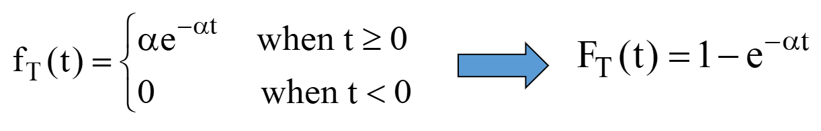
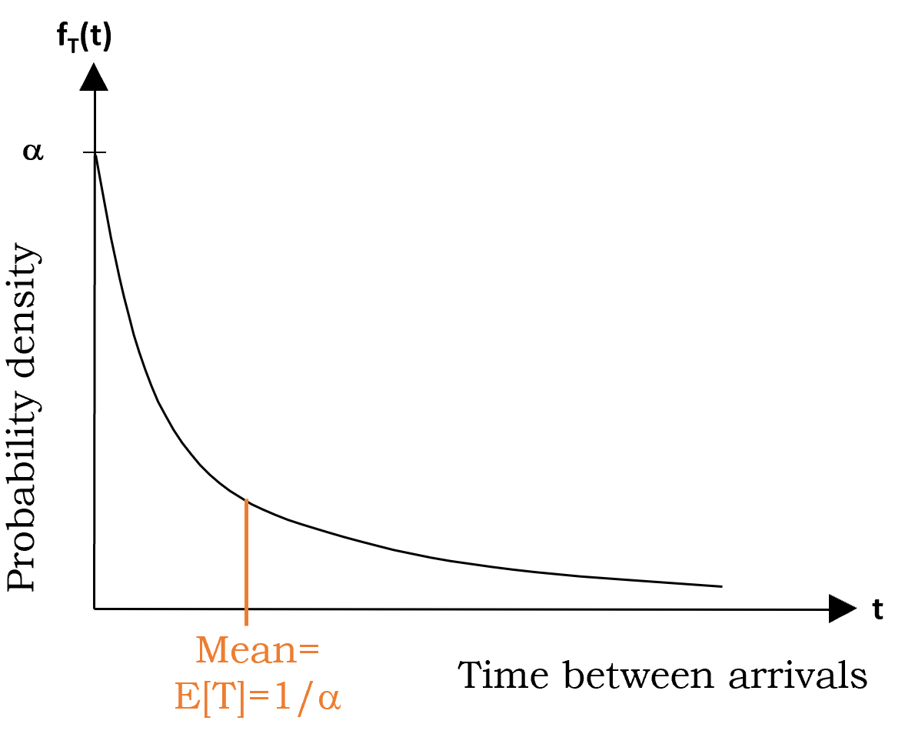

Some Queueing Systems
The Exponential Distribution for Interarrival Times
  The most commonly used queuing models are based on the assumption of exponentially distributed service times and interarrival times
  A random variable T∈exp(α ), i.e., is exponentially distributed with parameter α, if its density function is:
Memoryless property:
P(T>t+Δt | T>t) = P(T >Δt)
  The mean = E[T] = 1/α
  The Variance = Var[T] = 1/ α²
Probability density function is decreasing

Slide 30
Some Queueing Systems
The Exponential Distribution for Interarrival Times: Properties
  There is a high likelihood of small interarrival times, but a small chance of a very large interarrival time. This is characteristic of interarrival times in practice.
    Probability density function is decreasing
  For most queueing systems, the servers have no control over when customers will arrive. Customers generally arrive randomly.
    Having random arrivals means that interarrival times are completely unpredictable, in the sense that the chance of an arrival in the next minute is always just the same.
    The only probability distribution with this property of random arrivals is the exponential distribution.
    The fact that the probability of an arrival in the next minute is completely uninfluenced by when the last arrival occurred is called the lack-of-memory property (memoryless property).
    Memoryless property: P(T>t+Δt | T>t) = P(T >Δt)

Slide 31
Some Queueing Systems
M/M/1:
  Exponentially distributed interarrival times
  Exponentially distributed service times
  1 server, no system capacity
  One of the simplest systems
Additionally (not in the book)
The probability of seeing n customers in the system p(n)= (1 – ρ)ρ^{n}
The probability that the waiting time in the system exceeds t is P(W > t) = e^{–μ(1–ρ)t} for t ≥ 0
The probability that the waiting time in the queue exceeds t is P(W_{q} > t) = ρe^{–μ(1–ρ)t} for t ≥ 0
These are only for M/M/1
These will not hold true for other systems!!!

Slide 32
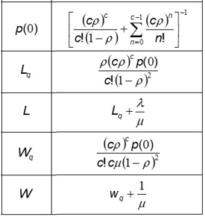
Some Queueing Systems
M/M/c:
  Exponentially distributed interarrival times
  Exponentially distributed service times
  c>1 servers, no system capacity
These are only for M/M/c such that c>1
These will not hold true for other systems!!!
There are additional formulae for calculating the probabilities for M/M/c (similar to M/M/1), but they are rather long and complicated

Slide 33

Some Queueing Systems
M/G/1:
  Exponentially distributed interarrival times
  Generically distributed service times (general distribution with mean ES(S)=1/μ and standard deviation σ)
  1 server, no system capacity
The probability of zero customers in the system is p(0) = 1 – ρ
The expected number of customers in the queue is L_{q} = [λ²σ² + ρ²] / [2(1 – ρ)]
The expected number of customers in the system is L = L_{q} + ρ ◊
The expected waiting time in the queue is W_{q} = L_{q} / λ ◊
The expected waiting time in the system is W = W_{q} + 1/μ ◊
These are only for M/G/1
These will not hold true for other systems!!!

Slide 34
Some Queueing Systems
M/G/1:
  Exponentially distributed interarrival times
  Generically distributed service times (general distribution with mean ES(S)=1/μ and standard deviation σ)
  1 server, no system capacity
The probability of zero customers in the system is p(0) = 1 – ρ
The expected number of customers in the queue is L_{q} = [λ²σ² + ρ²] / [2(1 – ρ)]
The expected number of customers in the system is L = L_{q} + ρ ◊
The expected waiting time in the queue is W_{q} = L_{q} / λ ◊
The expected waiting time in the system is W = W_{q} + 1/μ ◊
These are only for M/G/1
These will not hold true for other systems!!!

Slide 35
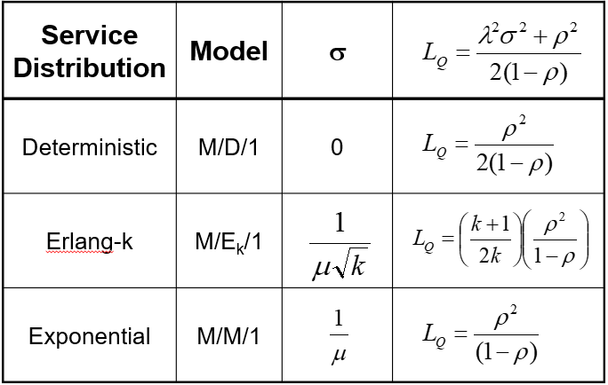
Some Queueing Systems
Others:
  Using M/G/1 results →
  No need to memorize these! They are available everywhere
    There are other online tools:
      https://www.supositorio.com/rcalc/rcalclite.htm
    See ‘Module 2.1 - Queueing Templates.xlsx’
    Source: “Introduction to Management Science: A Modeling and Case Studies Approach with Spreadsheets”, 5th edition, by F. S. Hillier and M. S. Hillier, McGraw-Hill Publication

Slide 36
Some Queueing Systems
‘Queueing Templates.xlsx’:
      It has different sheet, where each sheet has a specific queueing system
      Blue cells are the input cells, i.e., the ones that you can modify, the other cells should not be changed
        Source: “Introduction to Management Science: A Modeling and Case Studies Approach with Spreadsheets”, 5th edition, by F. S. Hillier and M. S. Hillier, McGraw-Hill Publication

Slide 37
Outline
Queueing-System Structure and Terminology
Key Performance Measures, Little’s Law, and Other Relations
Some Queueing Systems
M/M/1 Derivations
Review of Queueing Basics
  A Case Study and Key Insights

Slide 38
M/M/1 Derivations
Recall that:
  λ = Mean arrival rate for customers
  = Expected number of arrivals per unit time
  1/λ = expected interarrival time
  μ = Mean service rate (for a continuously busy server)
  = Expected number of service completions per unit time
  1/μ = expected service time
  ρ = the utilization factor
  = the average fraction of time that a server is busy serving customers
  = λ / μ

Slide 39
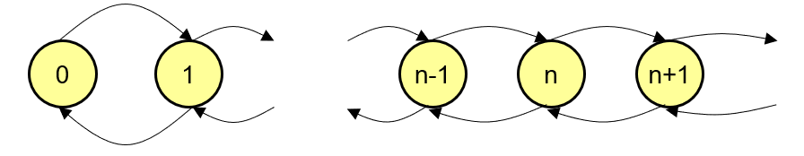
M/M/1 Derivations
Simplest model
  That is a Markov Chain
    Each state (the yellow nodes) is a possible number of customers in your queueing system
    Since infinitely possible states, we have infinite Markov Chain
  Transition rates
    Transition rate is the rate which you leave from a state and the rate which you enter a state λ μ

Slide 40
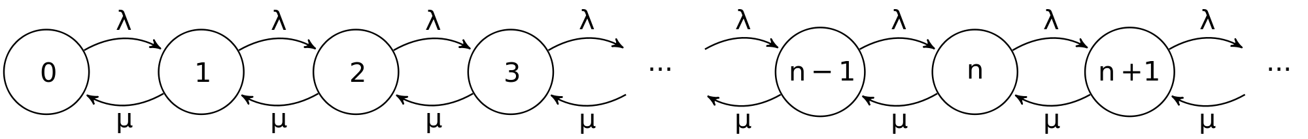
M/M/1 Derivations
Continuous time Markov Chain
  Conversation of Flow
  Rate in = Rate out
System State:
  n = # of customers in system
  p_{n} = P(n customers is the system)
Then → Rate in = Rate out → λp_{n-1} + μp_{n+1} = p_{n}(λ + μ)
Recursively, it can be shown that:
p_{n} = ρ^{n}(1-ρ) for ρ < 1
where ρ = λ/μ = utilization

Slide 41
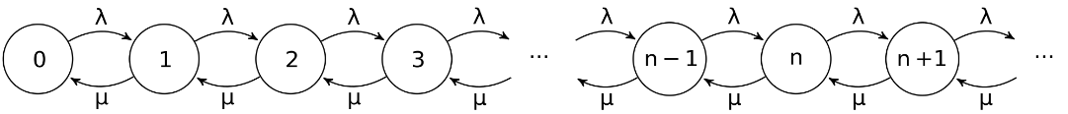
M/M/1 Derivations
Recursive calculation using λp_{n-1} + μp_{n+1} = p_{n}(λ + μ)
  λ P₀= μ P₁ → P₁ = λ/ μ P₀ → P₁ = ρP₀
  λ P₀ + μ P₂ = P₁(λ + μ) → P₂ = ρ²P₀
  λ P₁ + μ P₃ = P₂(λ + μ) → P₃ = ρ³P₀
  …………
    P_{n} = ρ^{n}P₀

Slide 42
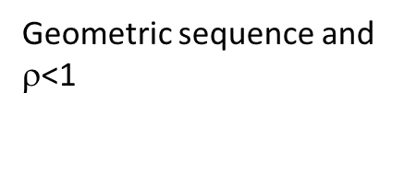



M/M/1 Derivations
Sum of probabilities is equal to 1
  P₀+ P₁+ P₂+ P₃+ P₄+…..
  $$\sum_{n=0}^{∞}{P_{n }}=1$$
  $$P_{0}\sum_{n=0}^{∞}{{\text{r}}^{n}}=1$$
$P_{0}$=1- $\text{r}$
p_{n} = ρ^{n}(1-ρ)
Geometric sequence and $\text{r}$<1
1/(1- $\text{r}$)

Slide 43
M/M/1 Derivations
Recall the performance measures
  L = Expected number of customers in the system, including those being served (the symbol L comes from Line Length).
  L_{q}= Expected number of customers in the queue, which excludes customers being served.
  W = Expected waiting time in the system (including service time) for an individual customer (the symbol W comes from Waiting time).
  W_{q} = Expected waiting time in the queue (excludes service time) for an individual customer
And the relations among these:
  L = λW
  L_{q} = λW_{q}
  W = W_{q} + 1/μ
  L = L_{q} + λ/μ
So, it is sufficient to find one of them

Slide 44
M/M/1 Derivations
L = E[# in system]

Slide 45
M/M/1 Derivations
Performance measures

Slide 46
Outline
Queueing-System Structure and Terminology
Key Performance Measures, Little’s Law, and Other Relations
Some Queueing Systems
M/M/1 Derivations
Review of Queueing Basics
  A Case Study and Key Insights

Slide 47
Review of Queueing Basics
Elements:
  λ = Mean arrival rate for customers = Expected number of arrivals per unit time
    1/λ = expected interarrival time
  μ = Mean service rate (for a continuously busy server) = Expected number of service completions per unit time
    1/μ = expected service time
  ρ = the utilization factor = the average fraction of time that a server is busy serving customers = λ / μ
Key performance metrics:
  L = Expected number of customers in the system, including those being served
  L_{q}= Expected number of customers in the queue, excludes customers being served.
  W = Expected waiting time in the system (including service time) for an individual customer
  W_{q} = Expected waiting time in the queue (excludes service time) for an individual customer
And the relations among these:
  L = λW
  L_{q} = λW_{q}
  W = W_{q} + 1/μ
  L = L_{q} + λ/μ

Slide 48
Review of Queueing Basics
Kendall’s Notation:
Results for some systems:
  M/M/1
  M/M/c
  M/G/1
  Others and Queueing Templates.xlsx!

Slide 49
A Case Study and Key Insights
Case: Company FIX provides maintenance services
Problem:
  Company FIX provides maintenance to its customers in a small area
    600 customers in total, each customer requests a maintenance service every 50 days on average
    To do so, a customer calls the company and automatically assigned to a maintenance employee based on the location of the customer (zip code)
    FIX employs 4 maintenance personnel
  Current policy: Each maintenance employee is assigned to a sub-area covering 150 customers. So, in total there are 4 independent sub-areas.
    Handling of a service request by a maintenance employee (travelling to customer site, providing maintenance, and coming back to the local office) takes about 0.25 day on average
  Complaints: There have been some complaints from customers about how long they wait until the maintenance employee starts the travel to the site.
    What can be done?

Slide 50
A Case Study and Key Insights
Case: Company FIX provides maintenance services
Queueing Elements:
  The customers: The customers requesting maintenance service.
  Customer arrivals: The requests for service.
  The queue: The service requests waiting for a maintenance employee to start the travel to the site of the request.
  The servers: The maintenance employee.
  Service time: The total time a maintenance employee is tied up with a request, including travel to and back from request site and maintenance time
Queueing systems:
  There are 4 independent single-server queuing systems because requests are assigned to employees based on location, and each employee has its own queue
  Arrival rates:
    Each employee is responsible for 150 customers
    Each customer requests a service every 50 days on average
So, 3 service requests per day on average (for each employee)

Slide 51

A Case Study and Key Insights
Case: Company FIX provides maintenance services
Current State:
  Observations: Service times and interarrival times are exponentially distribution
  Systems: There are 4 identical M/M/1 systems
  Each M/M/1:
    Mean arrival rate: $λ=3/day$
    Mean service time: $\frac{1}{μ}=0.25 day$
    Mean service rate: $μ=4/day$
For a M/M/1 :
Average waiting time of a customer from the time request made until the maintenance employee starts to travel to the request site is Wq=0.75 days (6 hours assuming a day is a 8-hour work day)
Note that, this is true for any customer from any sub-area because the M/M/1 systems for the sub-areas are identical
There are L=3 people from each sub-area in the company’s system on average → Therefore, there are 4*3=12 customers in the company’s system overall town on average
Each employee is busy 75% of the day on average

Slide 52
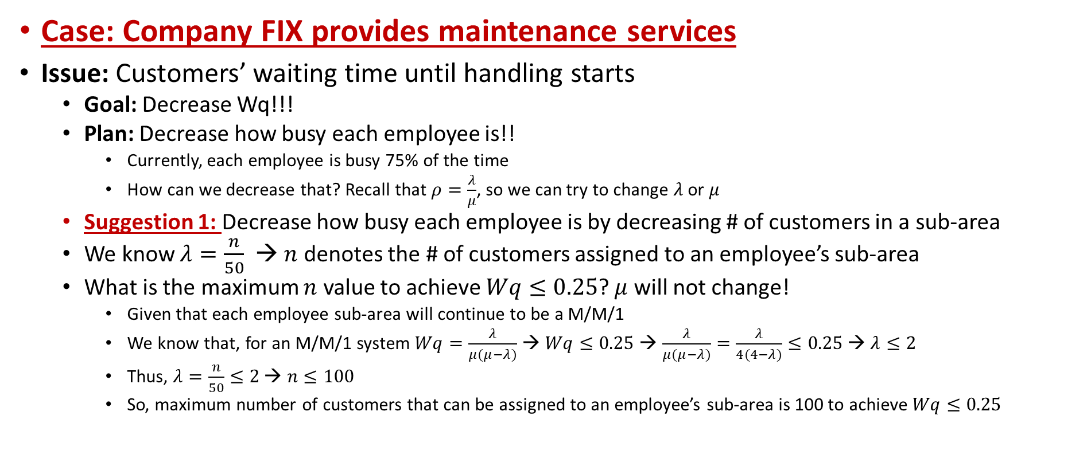
A Case Study and Key Insights
Case: Company FIX provides maintenance services
Issue: Customers’ waiting time until handling starts
  Goal: Decrease Wq!!!
  Plan: Decrease how busy each employee is!!
    Currently, each employee is busy 75% of the time
    How can we decrease that? Recall that $ρ=\frac{λ}{μ}$, so we can try to change $λ$ or $μ$
  Suggestion 1: Decrease how busy each employee is by decreasing # of customers in a sub-area
  We know $λ=\frac{n}{50}$ → $n$ denotes the # of customers assigned to an employee’s sub-area
  What is the maximum $n$ value to achieve $Wq≤0.25$? $μ$ will not change!
    Given that each employee sub-area will continue to be a M/M/1
    We know that, for an M/M/1 system $Wq=\frac{λ}{μ(μ−λ)}$ → $Wq≤0.25$ → $\frac{λ}{μ(μ−λ)}=\frac{λ}{4(4−λ)}≤0.25$ → $λ≤2$
    Thus, $λ=\frac{n}{50}≤2$ → $n≤100$
    So, maximum number of customers that can be assigned to an employee’s sub-area is 100 to achieve $Wq≤0.25$

Slide 53
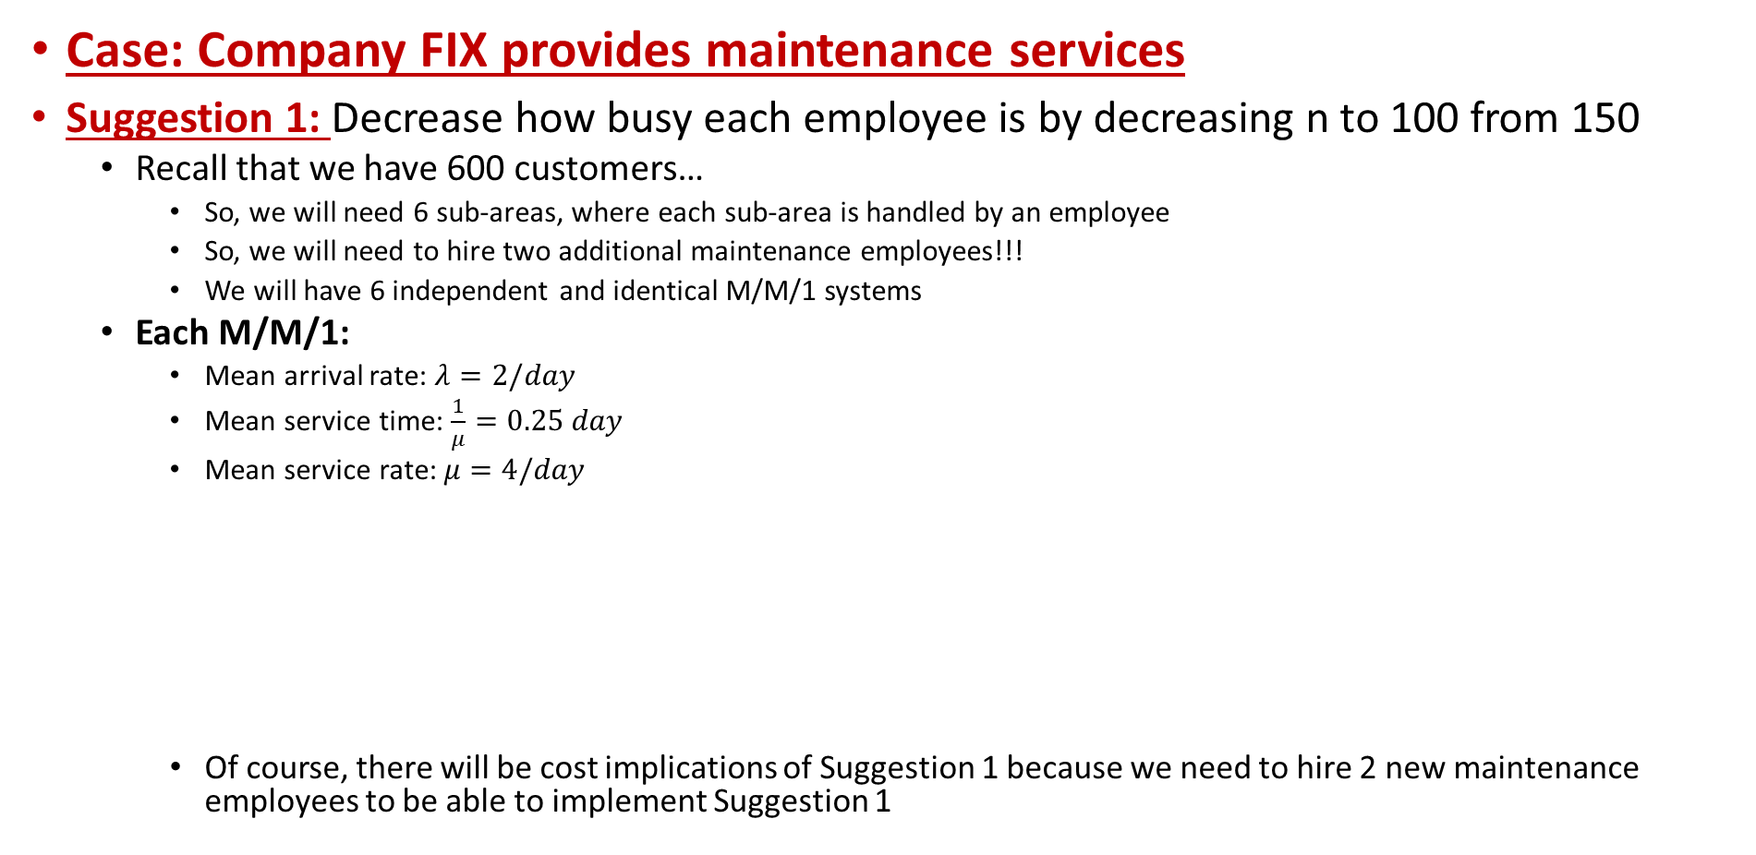
A Case Study and Key Insights
Case: Company FIX provides maintenance services
Suggestion 1: Decrease how busy each employee is by decreasing n to 100 from 150
  Recall that we have 600 customers…
    So, we will need 6 sub-areas, where each sub-area is handled by an employee
    So, we will need to hire two additional maintenance employees!!!
    We will have 6 independent and identical M/M/1 systems
  Each M/M/1:
    Mean arrival rate: $λ=2/day$
    Mean service time: $\frac{1}{μ}=0.25 day$
    Mean service rate: $μ=4/day$
    Of course, there will be cost implications of Suggestion 1 because we need to hire 2 new maintenance employees to be able to implement Suggestion 1
For a M/M/1 :
Average waiting time of a customer from the time request made until the maintenance employee starts to travel to the request site is Wq=0.25 days
Note that, this is true for any customer from any sub-area because the M/M/1 systems for the sub-areas are identical
There are L=1 people from each sub-area in the company’s system on average → Therefore, there are 6*1=6 customers in the company’s system overall town on average
Each employee is busy 50% of the day on average

Slide 54
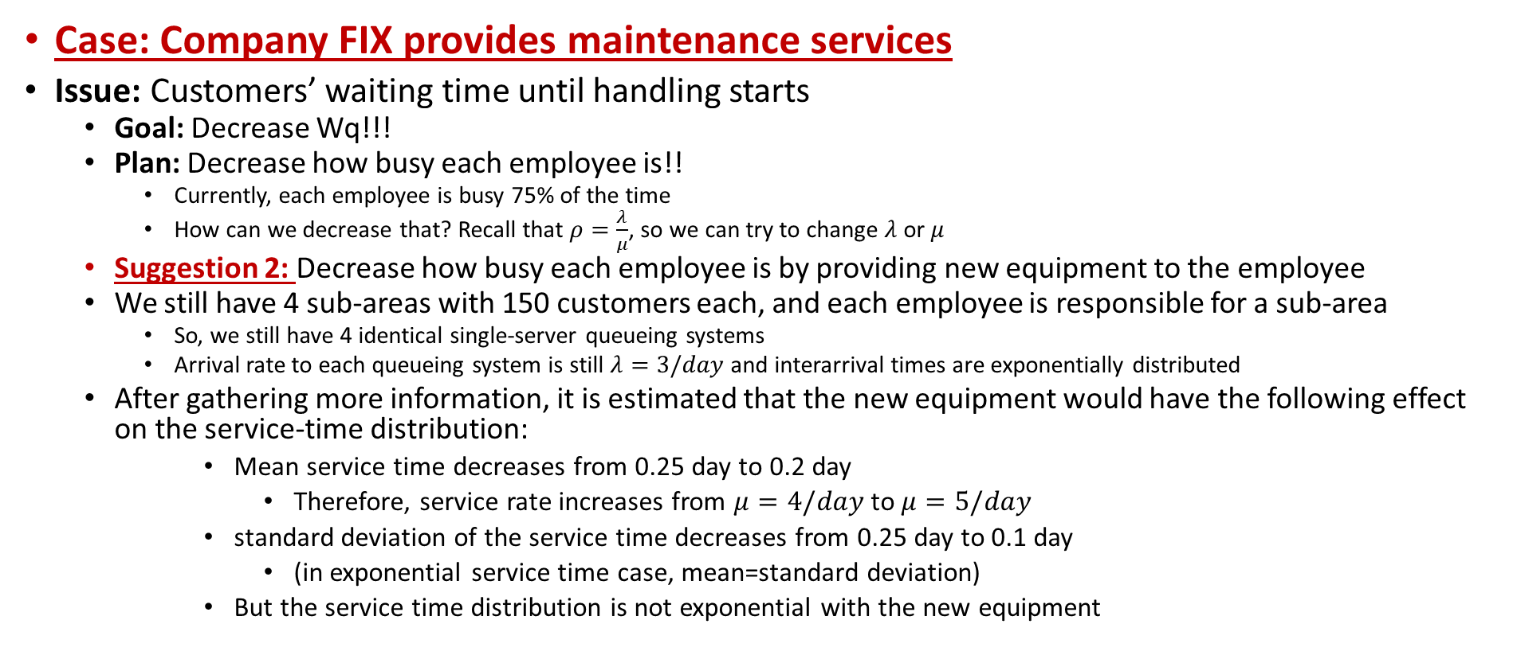
A Case Study and Key Insights
Case: Company FIX provides maintenance services
Issue: Customers’ waiting time until handling starts
  Goal: Decrease Wq!!!
  Plan: Decrease how busy each employee is!!
    Currently, each employee is busy 75% of the time
    How can we decrease that? Recall that $ρ=\frac{λ}{μ}$, so we can try to change $λ$ or $μ$
  Suggestion 2: Decrease how busy each employee is by providing new equipment to the employee
  We still have 4 sub-areas with 150 customers each, and each employee is responsible for a sub-area
    So, we still have 4 identical single-server queueing systems
    Arrival rate to each queueing system is still $λ=3/day$ and interarrival times are exponentially distributed
  After gathering more information, it is estimated that the new equipment would have the following effect on the service-time distribution:
      Mean service time decreases from 0.25 day to 0.2 day
        Therefore, service rate increases from $μ=4/day$ to $μ=5/day$
      standard deviation of the service time decreases from 0.25 day to 0.1 day
        (in exponential service time case, mean=standard deviation)
      But the service time distribution is not exponential with the new equipment

Slide 55
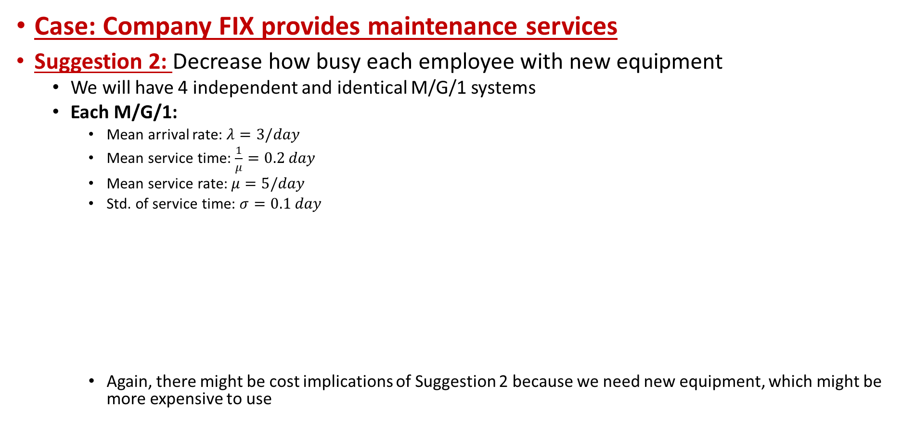
A Case Study and Key Insights
Case: Company FIX provides maintenance services
Suggestion 2: Decrease how busy each employee with new equipment
  We will have 4 independent and identical M/G/1 systems
  Each M/G/1:
    Mean arrival rate: $λ=3/day$
    Mean service time: $\frac{1}{μ}=0.2 day$
    Mean service rate: $μ=5/day$
    Std. of service time: $σ=0.1 day$
    Again, there might be cost implications of Suggestion 2 because we need new equipment, which might be more expensive to use
For a M/G/1 :
Average waiting time of a customer from the time request made until the maintenance employee starts to travel to the request site is Wq=0.188 days
Note that, this is true for any customer from any sub-area because the M/G/1 systems for the sub-areas are identical
There are L=1.163 people from each sub-area in the company’s system on average → Therefore, there are 4*1.163=4.652 customers in the company’s system overall town on average
Each employee is busy 60% of the day on average

Slide 56


A Case Study and Key Insights
A Key Insight:
Both Suggestions 1 and 2 under the plan for reducing an employee’s utilization ($ρ$) achieved better performance for W, Wq, overall L..
As utilization of the servers decrease, the system performs better!
In many practical cases, managers try to keep $ρ$ below a certain threshold
When designing a single-server queueing system, beware that giving a relatively high utilization factor (workload) to the server provides surprisingly poor performance for the system
Also, decreasing the variability of service times (without any change in the mean) substantially improves the performance of a queueing system.
L and W
Utilization

Slide 57
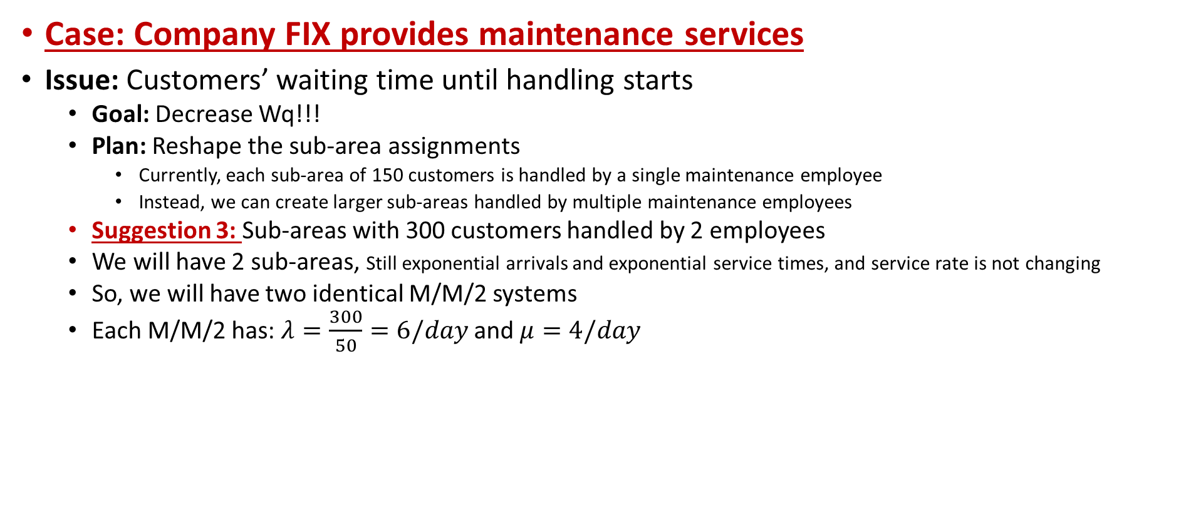
A Case Study and Key Insights
Case: Company FIX provides maintenance services
Issue: Customers’ waiting time until handling starts
  Goal: Decrease Wq!!!
  Plan: Reshape the sub-area assignments
    Currently, each sub-area of 150 customers is handled by a single maintenance employee
    Instead, we can create larger sub-areas handled by multiple maintenance employees
  Suggestion 3: Sub-areas with 300 customers handled by 2 employees
  We will have 2 sub-areas, Still exponential arrivals and exponential service times, and service rate is not changing
  So, we will have two identical M/M/2 systems
  Each M/M/2 has: $λ=\frac{300}{50}=6/day$ and $μ=4/day$
For a M/M/2 :
Average waiting time of a customer from the time request made until the maintenance employee starts to travel to the request site is Wq=0.321 days
Note that, this is true for any customer from any sub-area because the M/M/2 systems for the sub-areas are identical
There are L=3.43 people from each sub-area in the company’s system on average → Therefore, there are 2*3.43=6.86 customers in the company’s system overall town on average
Each employee is busy 75% of the day on average

Slide 58

A Case Study and Key Insights
Case: Company FIX provides maintenance services
Issue: Customers’ waiting time until handling starts
  Goal: Decrease Wq!!!
  Plan: Reshape the sub-area assignments
    Currently, each sub-area of 150 customers is handled by a single maintenance employee
    Instead, we can create larger sub-areas handled by multiple maintenance employees
  Suggestion 4: A single area with 600 customers handled by 4 employees
  We will have 1 sub-area, Still exponential arrivals and exponential service times, and service rate is not changing
  So, we will have one M/M/4 system
  M/M/4 has: $λ=\frac{600}{50}=12/day$ and $μ=4/day$
For the M/M/4 :
Average waiting time of a customer from the time request made until the maintenance employee starts to travel to the request site is Wq=0.127 days
There are L=4.52 people from in the company’s system overall town on average
Each employee is busy 75% of the day on average

Slide 59
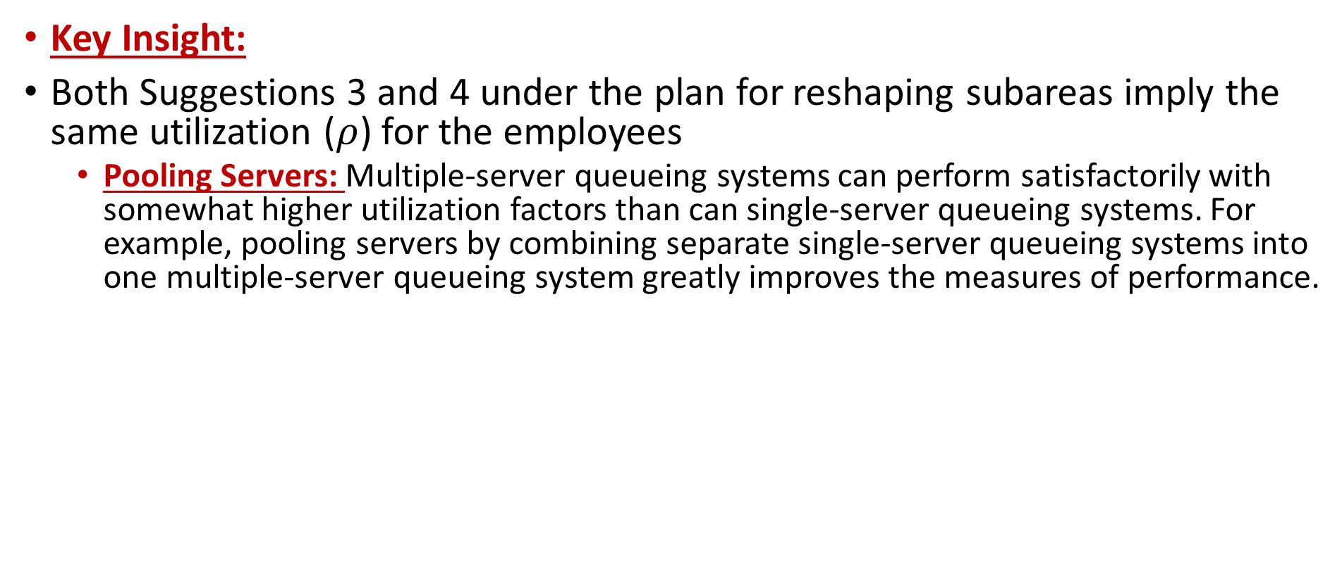
A Case Study and Key Insights
Key Insight:
Both Suggestions 3 and 4 under the plan for reshaping subareas imply the same utilization ($ρ$) for the employees
  Pooling Servers: Multiple-server queueing systems can perform satisfactorily with somewhat higher utilization factors than can single-server queueing systems. For example, pooling servers by combining separate single-server queueing systems into one multiple-server queueing system greatly improves the measures of performance.
  Wq(for combined system) < Wq(for each single-server system)/n

